Slide 1
RTS Product Status
Loukis Agrotis and Mark Caissy
IGS GB 43
Pasadena
22 June 2014

Slide 2
Contents
GPS Products
GPS+GLONASS Products
Conclusions

Slide 3
GPS Products
Eight ACs (BKG, CNES, DLR, ESOC, GFZ, GMV, NRCan and Wuhan) have continued their contributions this year
Two combination products
IGS01/IGC01 epoch-wise (ESOC s/w)
IGS02/IGC02 Kalman (BKG s/w)
Monitoring through daily comparisons against IGS rapids and continuous PPP (BKG)
Solutions stable but biases are affecting IGS01 clock combination (slight degradation over time)
No service outages since IOC
occasional orbit issues with Block IIF satellites

Slide 4
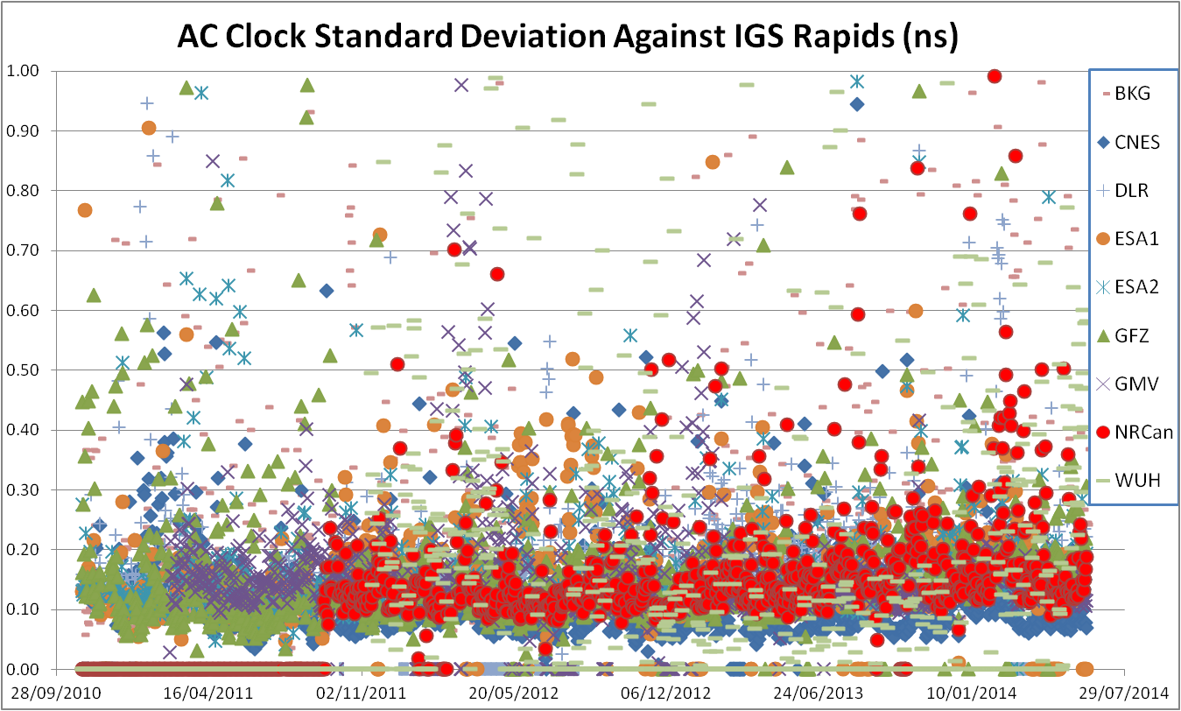
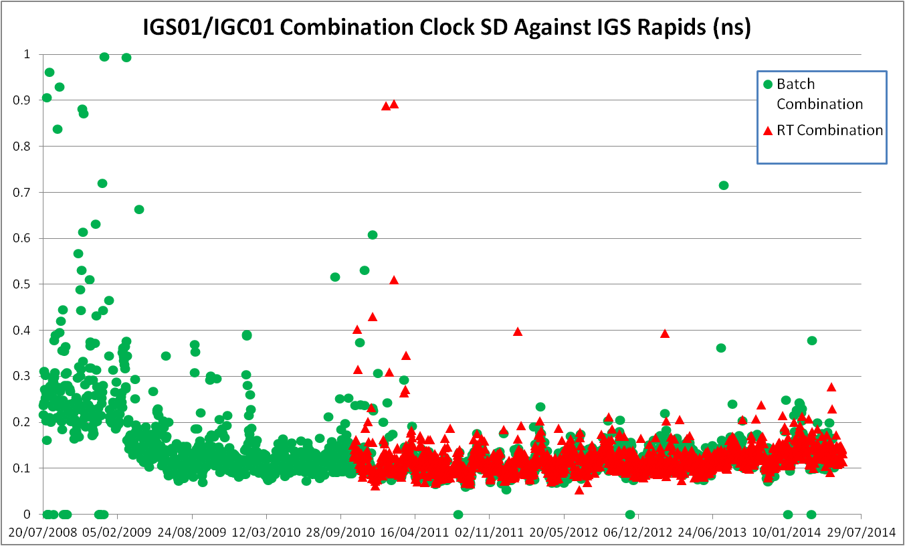
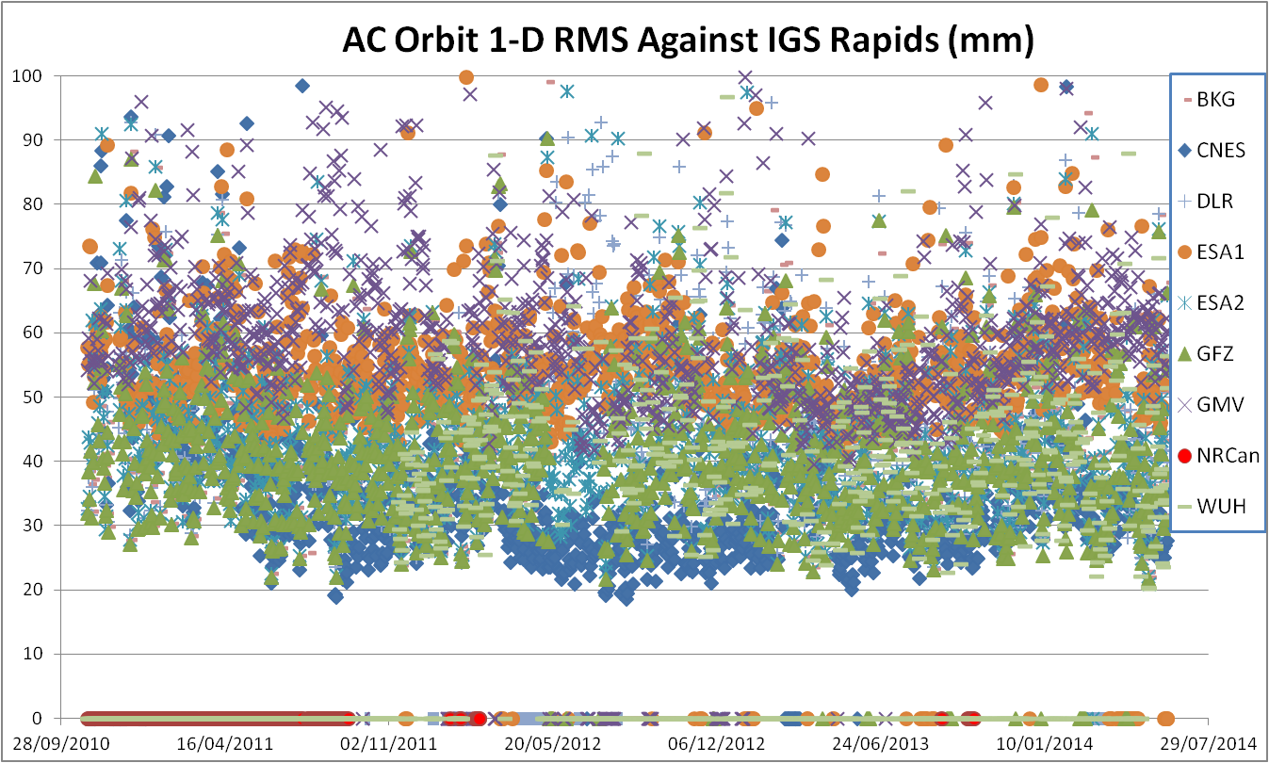
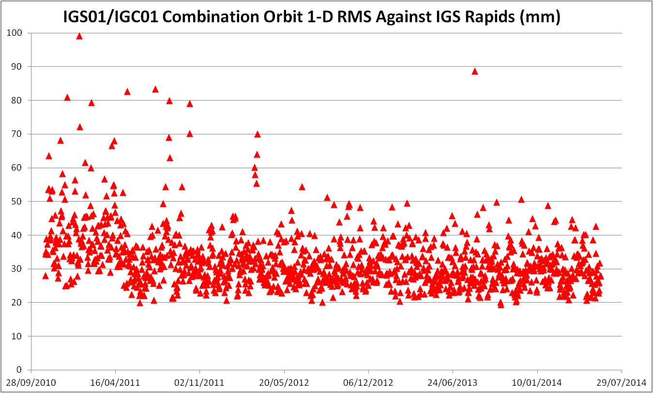
GPS Products
AC and IGS01 Clock and Orbit Performance Against IGS Rapids

Slide 5
GPS+GLONASS Products
Four ACs (BKG, CNES, DLR and GMV)
IGS03 (experimental) combination product from BKG
ESOC has developed software for generating sp3 and clock RINEX files from the RTCM streams and for generation of product comparisons. The BNC tool is an element in this process for converting the binary RTCM corrections to ASCII
RT ACC uses these files to generate daily GLONASS orbit and clock comparisons against the ESA rapid product.

Slide 6
GPS+GLONASS Products
Issues Encountered:
The GLONASS BE was corrupt April 1-2 2014
A corruption in the GLONASS part of ephemeris stream RTCM3EPH was resulting in incorrect RTCM encoding and decoding of the GLONASS solutions. This did not affect the DLR and GMV solutions, which are using a different ephemeris stream (resolved).
Incorrect treatment of the relativistic correction term resulted in erroneous RTCM encoding of the solution from some ACs (resolved).
The IGS03 combination and the BKG solution were showing reduced availability since the beginning of May (resolved).
Some unexplained jumps in IGS03 combination (pending).

Slide 7
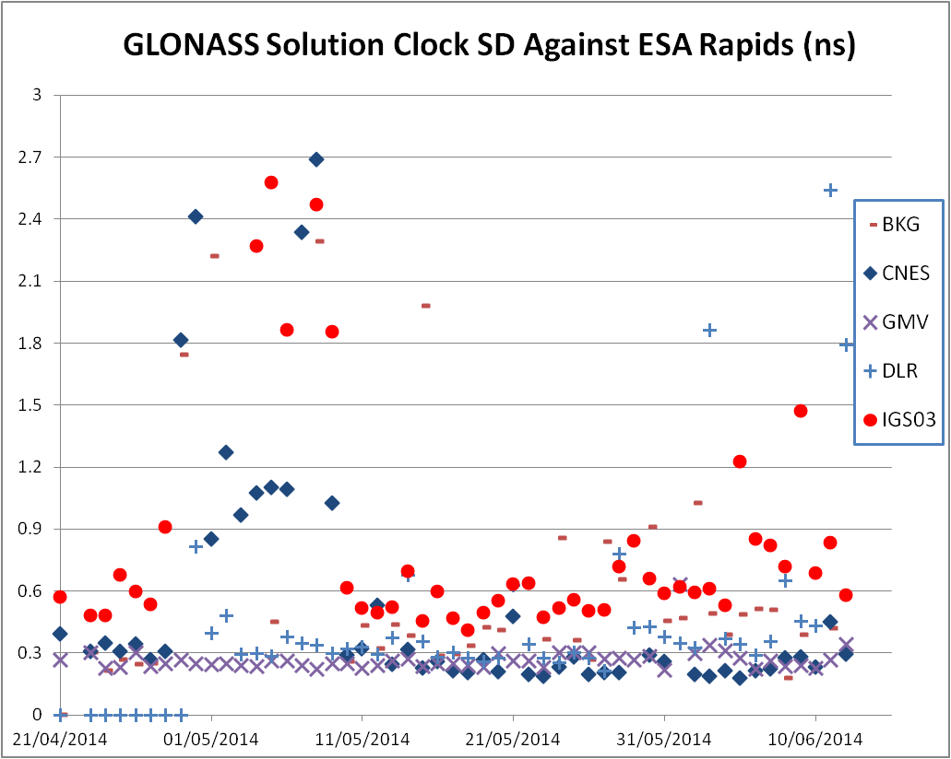
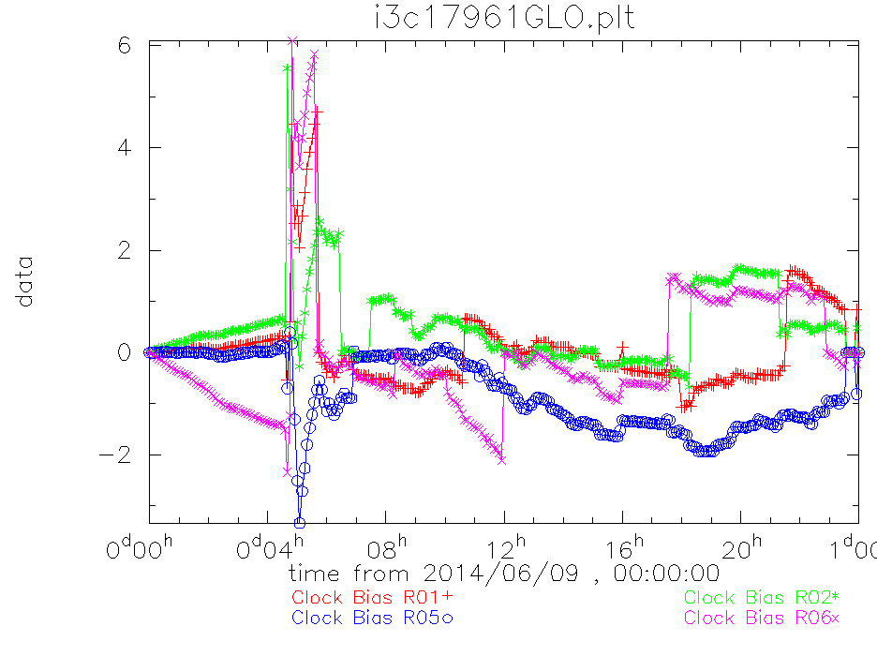
GPS+GLONASS Products
AC and IGS03 Clock Performance against ESA rapids, showing issue with corrupt ephemeris stream in early May
IGS03 residuals from ESA rapid daily comparison, showing issue with clock discontinuities

Slide 8
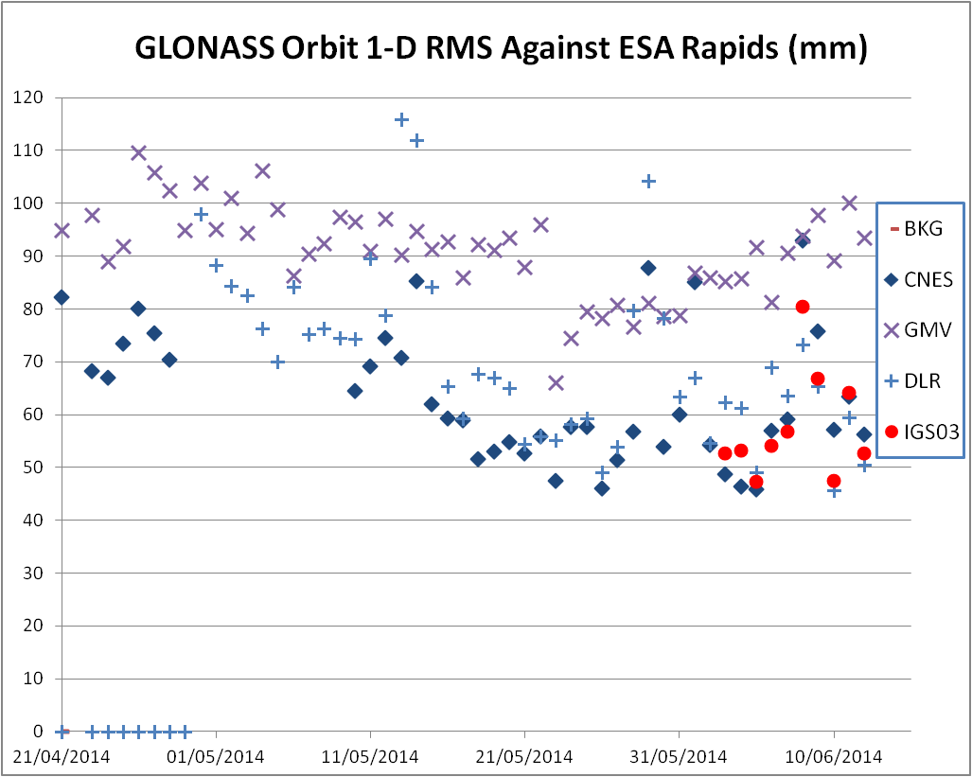
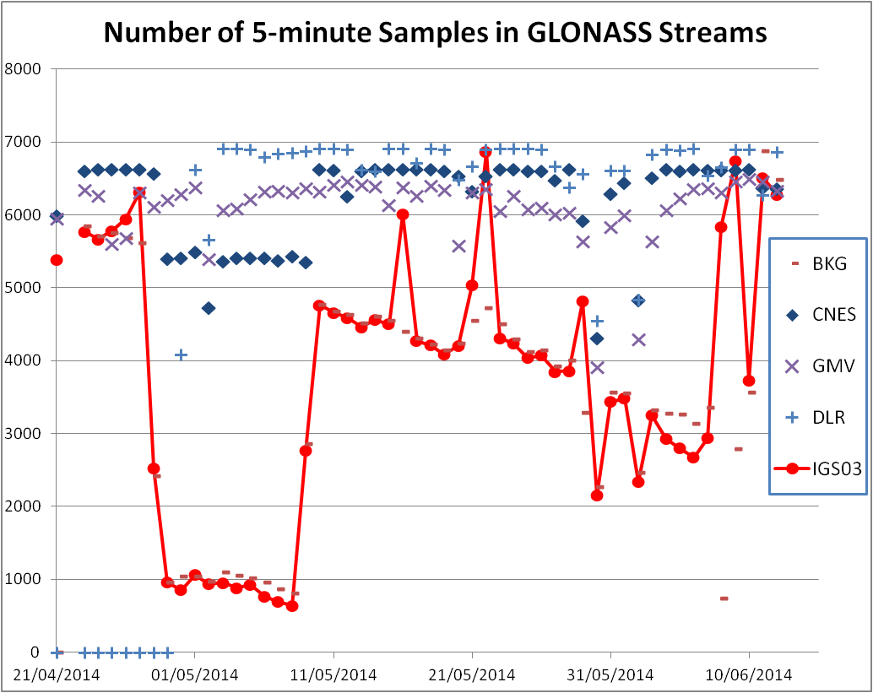
GPS+GLONASS Products
AC and IGS03 Orbit Performance against ESA rapids (corrupt ephemeris stream in early May disrupted CNES and BKG solutions)
Number of 5-minute daily clock samples are an indication of solution availability. The plot indicates the lack of availability in IGS03/BKG solutions (now resolved)

Slide 9
Conclusions
The IGS has provided a continuous, consistent and highly available GPS RTS service
A number of issues have been identified and resolved in the GLONASS products
There is one outstanding issue with the IGS03 GPS+GLONASS combination that has to be resolved before the stream is declared operational
Number of GLONASS ACs may need to increase for a reliable service

